Slide 1


Accelirate Prior Authorizations with AI Agents in Revenue Cycle Management​
How Agentic Process Automation can streamline and accelerate Prior Authorizations in Healthcare

Slide 2
Accelirate’s Healthcare Transformation Solutions Roadmap
Pre-Reg & Access Verify eligibility, benefits, pre-auth
Clinical Care
Patient Support/Care Coordination
Emergency
Inpatient Units
Outpatient Clinic
Surgery
Patient Estimation — Calculate out-of-pocket responsibility
Care Coordination
Social Services
Discharge Plan
Charge Capture — Find missing/duplicate charges
Education & Research
Medical Education
Nursing Education
Continuing Professional Development
HIM / Coding — Cross-check with payer/HIM rules
THE INTEGRATED HEALTHCARE PROVIDER
Revenue Cycle Management
UR / Case Mgmt — LOS & auth alerts for timely discharge
Administrative & Operational
Information & Technology
Information & Technology
Human Resources
Finance
Compliance
Claims — Validate and submit clean claims
Electronic Medical Records (EMR)
IT Support
Data Analytics
Quality, Safety & Regulatory
Remits & Denials — Post payments, work denials & appeals
Quality Improvement
Patient Safety
Office
Ancillary Services
Laboratory
Imaging
Pharmacy
Rehabilitation
Notes:
Items 1 – 7 should reflect our content roadmap

Slide 3
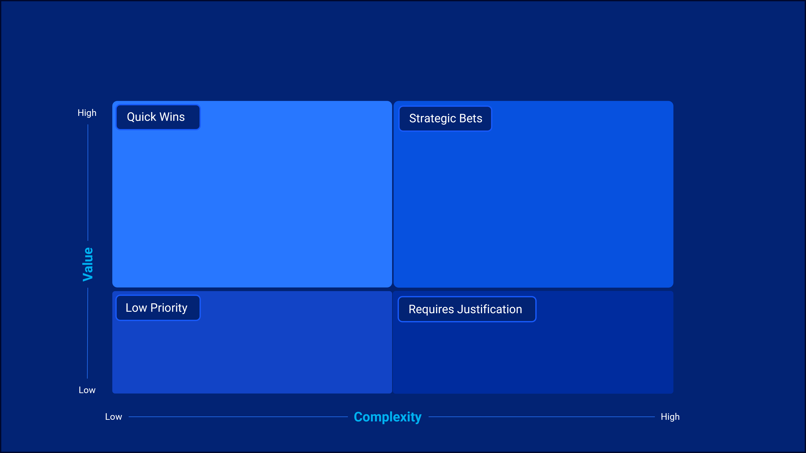
Where do we start in revenue cycle?
Denials Management
Patient Access / Registration
Insurance Follow-up
Utilization Review / Case Management
Claims Submission
Coding
Pre-Registration
Patient Payment Estimation

Slide 4

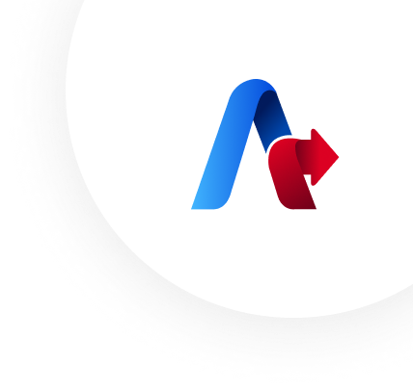



The Growing Challenges of Healthcare
Prior Authorizations
How prior authorizations impact finances, operations, and patient care​
Prior Authorization (PA) is widely recognized as one of the most fragmented and burdensome processes in healthcare. Hospitals and providers face growing complexity from hundreds of payers, shifting requirements, and manual workflows that consume valuable clinical time.
1. Financial Impact
2. Operational Burden
Hospitals must manage requests from 200+ payers, each with different formats and evolving policies.
Lack of industry standardization leads to inconsistent and error-prone submissions.
Electronic Medical Records (EMRs) offer little to no integration with payer systems
90% of prior authorizations are still processed manually, creating delays and bottlenecks.
PA requests take 20–45 minutes just to determine requirements.
Highly trained clinical staff are diverted from patient care to administrative tasks.
4. Impact on Patient Care
3. Financial Consequences
Care delivery is delayed while prior authorizations are processed.
Patients experience frustration, postponed procedures, and potential deterioration in health outcomes.
High denial rates further extend time-to-treatment and reduce provider trust.
Denials from missing or incomplete prior auths cost health systems up to $1.1M per 1,000 denials.
Manual errors and delays increase write-offs and threaten revenue capture.
Average cost of a single PA request is $25, adding up across thousands of cases.
What if you could reduce prior authorization delays and accelerate patient access to care with AI-driven automation? Our Agentic AI-powered RPA solutions streamline intake and verification , ensure submission accuracy , and maximize approval rates

Slide 5

Fast-track Prior Authorization Management with Accelirate's AI-Powered RPA Solutions ​
AcceliHealth transforms the prior authorization lifecycle by deploying a workforce of intelligent AI agents that work alongside your team.
Faster Insurance Verification
Accurate Authorization Determination
Achieve Scalability
Resolve Issues Proactively​
Enhance Patient Experience
Minimal involvement—RPA handles structured tasks. Automates EHR login, retrieves patient information, and validates eligibility directly with payer systems.
Interprets payer policy documents and identifies whether prior authorization is required for specific procedures. Submits CPT/HCPCS codes to payer portals or APIs to confirm requirements for straightforward cases.
Reads, interprets, and verifies the most recent payer policies, ensuring compliance with complex, changing rules. Automates policy lookups and integrates confirmed requirements into the workflow.
Extracts and summarizes clinical notes, lab results, and medical necessity evidence from unstructured data. Escalates to human staff when ambiguity is detected.
Interprets unstructured payer responses (e.g., “pended due to missing labs”) and triggers follow-ups or escalations.
Outcome
Outcome
Outcome
Outcome
Outcome
Outcome: Reduces upfront administrative burden, enabling staff to focus on patient scheduling rather than repetitive checks.
Eliminates unnecessary prior auth requests, avoids missed requirements, and lowers denial rates.
Improves accuracy, ensures policy compliance, and reduces denials tied to outdated or incomplete documentation.
Cuts down clinical staff workload, accelerates submission readiness, and improves completeness of prior auth packages.
Prevents delays in care, ensures timely resolution of pending cases, and reduces costly write-offs.

Slide 6



Evolution of Prior Authorization with Automation & Al
Only a full platform provides holistic value
Patient Scheduling or Registration
Insurance Verification
Identification of Preauthorization Requirements
Clinical Documentation Collection
Preauthorization Submission
Payor Response & Follow Up
Patient Notification
Authorization Approval or Denial
Authorization Reconciliation
Patient Scheduling or Registration
Insurance Verification
Identification of Preauthorization Requirements
Clinical Documentation Collection
Preauthorization Submission
Payor Response & Follow Up
Authorization Approval or Denial
Patient Notification
Authorization Reconciliation
Evolution of automation
Patient Scheduling or Registration
Insurance Verification
Identification of Preauthorization Requirements
Clinical Documentation Collection
Preauthorization Submission
Payor Response & Follow Up
Authorization Approval or Denial
Patient Notification
Authorization Reconciliation
Employee Work
Partial Automation
Automation
Human in the loop for input and validation
RPA for repetitive, rule-based decisions
Agent for non-deterministic intelligent automation

Slide 7


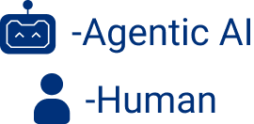

How AI-Powered Assistance Supports Your Healthcare Teams in Prior Authorizations
01
02
Advanced AI & RPA Solutions
Clinical Documentation Collection & Preauthorization Submission
Patient Intake and Coverage Verification
03
​Tailored Implementation
Authorization Decision and Management
Pre-Authorization Processing for Patient Access Center
What tasks in your revenue cycle could benefit from automation?
Let's discuss!

Slide 8
Health Care Employee and AI Assistant Relationship
Patient Intake and Coverage Verification Agent
Authorization Request and Documentation Agent
Authorization Decision and Management
Agent
Post-Service Review and Reconciliation Agent
Patient Scheduling or Registration
Insurance Verification
Identification of Preauthorization Requirements
Clinical Documentation Collection
Preauthorization Submission
Payor Response & Follow Up
Authorization Approval orDenial
Patient Notification
AuthorizationReconciliation
Payment Receipt & Retrieval
Contract & Denial Analysis Agent
Reconciliation & Exception Resolution
Schedule patient appointments or register patients for admission.
Verify basic patient demographics and contact information.
Record initial patient insurance details and reason for visit.
Confirm patient’s insurance coverage and eligibility.
Identify if specific services or procedures require preauthorization.
Document verification results in the patient’s electronic record.
Review scheduled procedures or services against payer-specific preauthorization rules.
Clearly flag services requiring preauthorization within internal systems.
Communicate preauthorization needs to clinical and administrative teams.
Gather relevant clinical documentation from patient records (e.g., diagnosis, test results).
Ensure collected documentation meets payer-specific criteria.
Confirm completeness and accuracy before preauthorization submission.
Prepare and submit complete preauthorization requests through payer portals or electronic clearinghouses.
Record submission details including tracking numbers and submission dates.
Maintain logs for submitted authorizations and track submission statuses.
Monitor responses from payers, documenting approvals or denials.
Respond promptly to requests from payers for additional in formation or clarification.
Conduct regular follow-up to expedite delayed responses.
Update internal records immediately upon receiving authorization decisions.
Clearly document reasons for denial to inform further actions or appeals.
Notify clinical teams of authorization results to proceed accordingly.
Inform patients of preauthorization outcomes clearly and promptly.
Provide patients with guidance on next steps based on outcomes.
Reschedule or confirm appointments based on authorization status.
Cross-check authorized services against billed services after patientcare.
Identify and resolve discrepancies or mismatches promptly.
Maintain accurate documentation to support billing and compliance.

Slide 9
The Prior Authorization Agentic Journey
Stage 1
Stage 2
Stage 3
Stage 4
Patient Intake & Coverage Verification
Clinical Documentation Collection & Submission
Authorization Decision & Management
Pre-Authorization Processing & Patient Access Center
2- 3 Months / 25% of Opportunity
4-8 Months / 30% of Opportunity
6-9 Months / 25% of Opportunity
9- 12 Months / 15% of Opportunity
Goals
Establish centralized intake of eligibility and coverage checks across EHR and payer portals
Eliminate manual demographic entry and reduce intake-related errors
Provide real-time coverage validation to prevent downstream denials
Centralize retrieval of clinical documents from EHR, PACS, and LIS systems
Eliminate manual chart hunting and reduce incomplete submissions
Provide payer-ready documentation packages that align with current policies
Centralize capture of payer responses across fax, email, portals, and EDI
Eliminate manual monitoring and reduce missed updates or RFIs
Provide structured decision data to accelerate follow-ups and appeals
Establish centralized queue management for all pending prior auth cases
Eliminate manual prioritization and repetitive portal navigation
Provide real-time case status updates to providers, schedulers, and patients
Use Cases
Automated payer eligibility checks
Real-time demographic validation at scheduling
Flagging PA requirements directly in EHR
Up to 70% faster insurance verification, fewer denials due to intake errors.
NLP/OCR to validate clinical notes against payer requirements
Auto-generation of payer-specific checklists
Retrieval of labs, imaging, and charts across EHR systems
Assemble standardized documentation packets → faster payer responses.
Continuous monitoring across fax, portals, EDI, and emails
AI extraction of approval/denial details from unstructured payer messages
SLA-driven alerts and automated escalations
Structured denial capture for appeals, cutting manual monitoring time by 50%.
Appeal outcome tracking and analytics
Root cause analysis (eligibility, coding, prior auth)Continuous improvement feedback to upstream workflows
Predictive denial prevention (flagging claims pre-submission)
Notes:
Where to start, why it matters.

Slide 10



Prior Authorization Processing for Patient Access Center
Business Challenges
Lower cost and risk of missed authorizations.
Financial Impact
Manual navigation of EHR queues and payer portals is slow.
Inconsistent prioritization leads to delayed high-risk cases.
Coverage mismatches or missing data cause business exceptions.
Repetitive data entry into trackers and portals wastes staff hours.
Streamlined automation reduces the cost per authorization and prevents lost revenue from missed or delayed approvals. It accelerates reimbursement cycles by boosting throughput.
Process Workflow
Unattended Automation
Quick Wins
Log into EHR and assign cases based on priority rules.
Validate coverage, CPT/ICD codes, and patient/provider details
Run eligibility verification and collect required documentation
Submit authorization request via payer portal
Update referral/tracker and send communications to providers
Lower cost and risk of missed authorizations.
Downstream Impact
Accurate and timely coverage validation minimizes downstream denials and ensures readiness for appeals if needed.
Technology Platforms: Any EHR Platform
Robotic Process Automation
Employee Supervision
Agent
Candidate
Key Automation Opportunities
Efficiency Gain
Smart Case Handling
Code & Coverage Validation
Automated Submission
Stakeholder Communication
Consistent, reliable updates for providers and patients.
50% reduction in manual triage time.
95% accuracy in extracting data from payer letters.
30% faster case closure compared to manual monitoring.
Automated queue navigation, case assignment, and prioritization.
AI-driven checks for CPT/ICD and insurance eligibility
Document assembly and direct payer portal entry.
Standardized provider notifications and updates.
Notes:
Need 1 slide per agent.

Slide 11
Patient Intake and Coverage Verification Agent
Business Challenges
Financial Impact
Fewer denials linked to eligibility mistakes
Automating intake and verification reduces denials tied to eligibility errors and lowers the average cost per verification by cutting staff hours. It protects revenue by preventing scheduling delays and missed authorizations.
Manual intake and insurance verification consumes up to 40% of staff time.
Error-prone data entry contributes to nearly 37% of denials.
Payer rules vary widely, creating inconsistent workflows.
Delays in eligibility checks lead to patient dissatisfaction and canceled appointments.
Process Workflow
Unattended Automation
Quick Wins
Extract Patient Demographics at scheduling
Validate Demographics in real time
Perform automated payer eligibility checks
Identify procedures requiring preauth
Flag requirements directly within EHR/scheduling
Faster patient scheduling and improved satisfaction.
Downstream Impact
Accurate data at the front end ensures smoother documentation collection and fewer unnecessary preauthorization requests. This enables cleaner, faster submissions downstream.
Technology Platforms: Any EHR Platform
Robotic Process Automation
Employee Supervision
Agent
Candidate
Key Automation Opportunities
Demographic Extraction:
Eligibility Verification:
Preauthorization Identification:
Rule Updates:
Efficiency Gain
Automatically capture and validate patient details at scheduling.
Run real-time checks with payer portals and APIs.
Continuously update requirements to stay compliant with payer changes.
Lower administrative burden and costs
Up to 70% faster insurance verification.
63% reduction in authorization turnaround times observed in case studies.
Staff redirected to patient-facing tasks instead of repetitive verification.
Flag procedures needing authorization using payer-specific rules.
Notes:
Need 1 slide per agent.

Slide 12
Clinical Documentation Collection & Preauthorization Submission Agent
Reduced auto-denials for incomplete submissions.
Business Challenges
Financial Impact
Payer requirements are inconsistent and frequently updated.
Data silos across EHR, PACS, LIS, and external portals slow collection.
Providers often deliver incomplete or narrative-only documentation.
Delays in clarifications/addenda stall scheduling windows.
Automation prevents denials caused by missing or incomplete documents and reduces costly rework. It also shortens AR days by accelerating submissions.
Process Workflow
Unattended Automation
Quick Wins
Identify services requiring preauth. and map payer requirements.
Retrieve patient records across systems (EHR, imaging, labs).
Validate documentation completeness and correlation with ICD-10/CPT codes
Compile, redact, and format into payer-ready submission packages
Submit through payer portal, EDI, fax, or API with confirmation logging
Faster turnaround and payer responses.
Downstream Impact
Stronger documentation packages cut down on payer “requests for more information,” ensuring smoother, faster reviews.
Technology Platforms: Any EHR Platform
Robotic Process Automation
Employee Supervision
Agent
Candidate
Key Automation Opportunities
Record Retrieval:
Narrative Validation:
Checklist Generation
Packet Preparation & Portal Submission
Significant reduction in manual document handling.
Efficiency Gain
Pull patient charts, labs, and imaging from multiple systems automatically.
Use NLP/OCR to check clinical notes against payer requirements.
Auto-build payer-specific documentation lists for each CPT/ICD.
Assemble, redact, and label payer-ready PDF submissions.
Upload requests with documents and capture confirmations.
Staff spend less time hunting records, and each submission becomes standardized and compliant, allowing higher throughput.
Notes:
Need 1 slide per agent.

Slide 13
Authorization Decision and Management Agent
Higher compliance with payer turnaround rules
Business Challenges
Financial Impact
Fragmented payer communication channels (fax, portals, EDI, phone).
Manual monitoring causes missed updates and delayed responses.
Denial letters often vague, slowing appeals.
High administrative burden from manual logging and tracking.
Automated monitoring reduces lost revenue from missed RFI deadlines and late follow-ups. It lowers denial-related write-offs by improving SLA compliance.
Process Workflow
Unattended Automation
Quick Wins
Submit request and Log case for monitoring
Continuously track payer responses across all channels
Triage incoming communications into approval, denial, or RFI
Respond to RFIs or escalate overdue cases
Record final decision, update systems
Notify providers, schedulers, and patients; launch appeals if denied
Faster and more reliable communication of payer decisions
Downstream Impact
Timely updates ensure schedulers, providers, and patients can act quickly, while structured denial capture strengthens appeal workflows.
Technology Platforms: Any EHR Platform
Robotic Process Automation
Employee Supervision
Agent
Candidate
Key Automation Opportunities
Unified Listener
AI Document Processing
Automated Escalation
Decision & Expiration Tracking
Improved appeal readiness with structured denial data
Efficiency Gain
AI-driven triage and escalation cut manual monitoring time in half and speed case closure by nearly 30%.
Continuously monitor fax, portals, EDI, email, and phone logs.
Extract decision codes, dates, and approval/denial details from unstructured messages.
SLA-based alerts trigger timely follow-ups and tasks.
Case status updates and reminders for approvals/denials.
Notes:
Need 1 slide per agent.

Slide 14

Impact of AI-Powered Solutions
Agentic AI autonomously navigates EMRs, payer systems, and queues to retrieve, verify, and submit authorizations - without human handoffs.
Fully autonomous workflows deployed in < 5 weeks
What Our Clients Say
80%+ cycle time reduction on common inpatient authorizations
"The automation work delivered for our team has exceeded expectations. A previously manual, multi-step process involving several systems was transformed into a streamlined, user-friendly experience. What once felt nearly impossible is now fully achievable thanks to this automation solution. The impact on our quality metrics and daily operations has been substantial. We’re eager to expand this capability across our broader network and are truly grateful for the collaboration and results delivered."
1000s of hours freed for clinical and rev cycle teams
6-figure impact per high-volume use case
​Ready to achieve results like these?
Let’s talk!

