Slide 1


Payment Posting
How agentic process automation can improve Payment Posting & Reconciliation for Revenue Protection​

Slide 2
Accelirate’s Healthcare Transformation Solutions Roadmap
Pre-Reg & Access Verify eligibility, benefits, pre-auth
Clinical Care
Patient Support/Care Coordination
Emergency
Inpatient Units
Outpatient Clinic
Surgery
Patient Estimation — Calculate out-of-pocket responsibility
Care Coordination
Social Services
Discharge Plan
Charge Capture — Find missing/duplicate charges
Education & Research
Medical Education
Nursing Education
Continuing Professional Development
HIM / Coding — Cross-check with payer/HIM rules
THE INTEGRATED HEALTHCARE PROVIDER
Revenue Cycle Management
UR / Case Mgmt — LOS & auth alerts for timely discharge
Administrative & Operational
Information & Technology
Information & Technology
Human Resources
Finance
Compliance
Claims — Validate and submit clean claims
Electronic Medical Records (EMR)
IT Support
Data Analytics
Quality, Safety & Regulatory
Remits & Denials — Post payments, work denials & appeals
Quality Improvement
Patient Safety
Office
Ancillary Services
Laboratory
Imaging
Pharmacy
Rehabilitation
Notes:
Items 1 – 7 should reflect our content roadmap

Slide 3
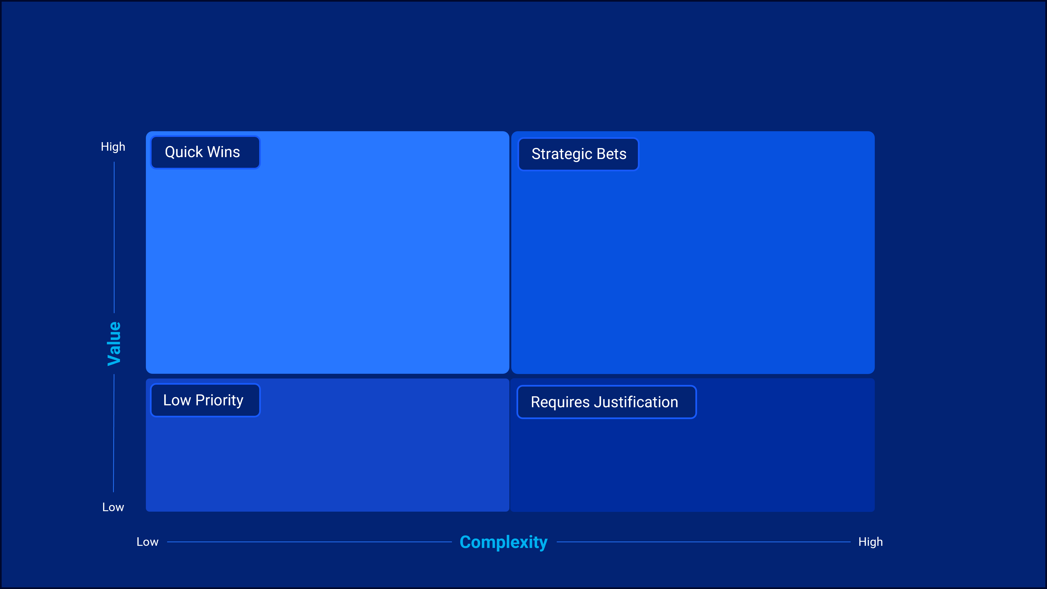
Where do we start in revenue cycle?
Payment Posting
Patient Access / Registration
Insurance Follow-up
Utilization Review / Case Management
Claims Submission
Coding
Denials Management
Pre-Registration
Patient Payment Estimation

Slide 4





The Growing Challenges of Healthcare Payment posting​
How Manual Payment Posting Impacts Finances, Operations, and Teams.​
Managing payment posting is a time-consuming, expensive process that puts financial and operational strain on healthcare providers. This process is highly manual, leading to delays and revenue loss.​
1. Revenue Leakage & Contract Complexity
2. Operational Burden
Underpayments and errors represent 1–11% of net revenue for providers.
Retrospective audits often uncover millions in missed underpayments
Payment teams spend disproportionate time cleaning inputs rather than applying payments.
Nearly 25% of U.S. healthcare spending is administrative, with manual posting being a significant contributor
3. Financial Consequences
4. Compliance & Visibility Gaps
With 75% of provider organizations reporting denial increases, posting delays directly constrain cash flow.
Inefficient reconciliation can push Days in A/R to 30–35+ days
  Inconsistent mapping of payer reason codes (CARC/RARC) creates compliance risk and audit exposure.
  Limited real-time insight into denial volumes and underpayment exposure restricts proactive management.
What if you could accelerate your cash flow and reduce operational costs with automated payment posting? Our Agentic AI-powered RPA solutions simplify payment posting, improve data accuracy, and maximize the efficiency of your revenue cycle.

Slide 5

Accelerate Payment Posting with AcceliHealth's AI Agents
By combining the cognitive intelligence of Agentic AI with the efficiency of RPA, your organization can experience:
Increased Speed & Efficiency
Reduced Revenue Leakage
Accelerated Reconciliation
Improved Quality & Compliance
RPA handles deterministic interactions like file handling and screen navigation
AI Agents perform the “thinking steps” like comparing contract terms and flagging underpayments..​
AI Agents reconcile deposits and detect and explain breaks in the ERA/EFT pairing.​
Shortens month-end close cycles and reduces manual reconciliation friction.
Outcome
Outcome
Outcome
Outcome
30–60% reduction in manual posting touches and compresses time-to-post from hours to near-real-time.
Earlier visibility into denials and underpayments, improving net collections through variance capture.
Shortens month-end close cycles and reduces manual reconciliation friction.
Explainable decisions with line-level rationales and improved audit readiness.

Slide 6





Evolution of Payment Posting with Automation & Al
All Manual Work
Evolution of Automation
Payment Receipt & Retrieval
Batch Creation / Payment Logging
Remittance Processing & Adjustment Decisioning
Contract & Denial Analysis
Reconciliation & Exception Resolution
Reporting & Exceptions
Utilizing RPA
Payment Receipt & Retrieval
Batch Creation / Payment Logging
Remittance Processing & Adjustment Decisioning
Contract & Denial Analysis
Reconciliation & Exception Resolution
Reporting & Exceptions
Utilizing Agentic Automation
Payment Receipt & Retrieval
Batch Creation / Payment Logging
Remittance Processing & Adjustment Decisioning
Contract & Denial Analysis
Reconciliation & Exception Resolution
Reporting & Exceptions
Manual Work
Partial Automation
Automation
Human in the loop for input and validation
RPA for repetitive, rule-based decisions
Agent for non-deterministic intelligent automation

Slide 7




How AI-Powered Assistance Supports Your Payment Posting Teams?
01
Remittance Intake & Normalization
02
Advanced AI & RPA Solutions
03
​Tailored Implementation
Posting & Adjustment Decisioning
Reconciliation & Resolution:
Contract & Denial Analysis
What tasks in your revenue cycle could benefit from automation?
Let's discuss!

Slide 8



Health Care Employee and AI Assistant Relationship
Remittance Intake & Normalization Agent
Posting & Adjustment Decisioning Agent
Contract & Denial Analysis Agent
Cash Reconciliation & Exception Resolution Agent
Payment Receipt & Retrieval
Batch Creation/ Payment Logging
Remittance Processing & Adjustment Decisioning
Contract & Denial Analysis Agent
Reconciliation& Exception Resolution
Reporting & Exceptions
Payment Receipt & Retrieval
Batch Creation/ Payment Logging
Remittance Processing & Adjustment Decisioning
Contract & Denial Analysis Agent
Reconciliation & Exception Resolution
Retrieve ERAs (835files) through payer clearing house,portals, or direct connections
Collect paperEOBs from mail, lockboxes, orscanning centers.
Access bank deposits for EFTs, checks, and patient payments.
Separate patient self-pay from insurance remittances for proper routing.
Create daily payment batches grouped by payer, location, or deposit source.
Record total deposit amounts for reconciliation later in the workflow
Attach documentation (ERA, EOB, deposit slip) to batch records.
Balance cash and check deposits against bank-reported deposits.
Import ERA 835 files into billing/practice management systems.
Manually key details from EOBs when electronic files are unavailable.
Apply payments, adjustments, reversals, and recoupments at the line level.
Review payer adjustment codes (CO,PR), OAT for financial impact.
Flag denials for follow-up; document root-causes and create denial tasks.
Compare allowed amounts to contracted rates; detect under/overpayments.
Classify denials using CARC/RARC codes and payer messages.
Generate variance and denial worklists with supporting documentation.
Suggest next-best actions (appeal, rebill, refund, write-off).
Match total payments posted against the actual bank deposit amounts.
Investigate variances (e.g., missing ERAs, unapplied cash, misapplied checks).
Escalate discrepancies for correction or exception handling.
Reconcile unapplied cash and ensure balances are allocated appropriately.
Run daily cash posting and reconciliation reports.
Track payer trends in denials, under payments,or posting delays.
Monitor exception queues and ensure timely resolution.
Provide leadership visibility into variances, exceptions, and workload volumes.

Slide 9
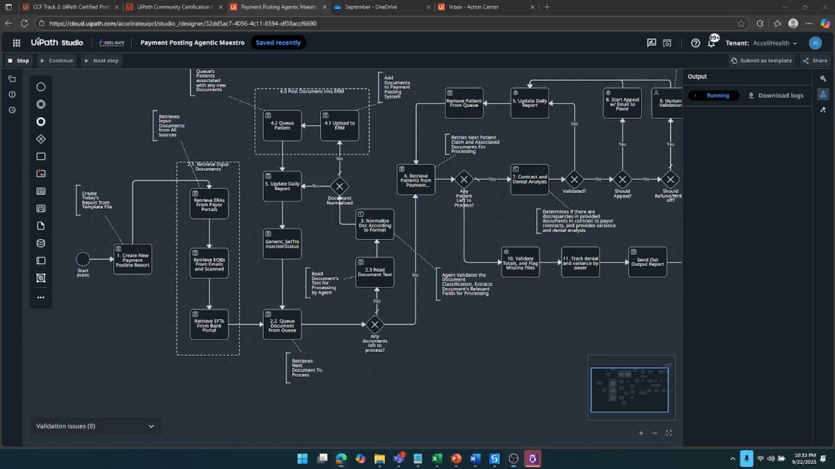
Demonstration of Payment Posting Agent

Slide 10
The Payment Posting Agentic Journey
Stage 1
Stage 2
Stage 3
Stage 4
Payment Receipt & Retrieval
Batch Creation / Payment Logging
Remittance Processing & Adjustment Decisioning
Contract & Denial Analysis
6-8 Months / 35% of Opportunity
8-10 Months / 30% of Opportunity
6-8 Months / 20% of Opportunity
6 Months / 15% of Opportunity
Goals
Establish centralized intake of all denials across 835s, EOBs, and payer portals
Process recordings, volume/time studies, CARC/RARC distribution, and backlog analysis
Accelerate decision-making on which denials to appeal
Improve compliance and payer-specific alignment in appeal letters
Standardize supporting documentation collection
Ensure timely, error-free submission of all appeals
Eliminate missed deadlines and manual portal checks
Provide real-time payer response tracking
Deliver continuous insights to reduce systemic denial causes
Enable proactive prevention of high-risk denials
Provide leadership dashboards for denial trends and payer behaviors
Use Cases
Automated denial code extraction
Denial classification by payer/type
Trend monitoring & alerts
Centralized denial repository
AI-driven appeal prediction (probability scoring)Automated appeal letter generation
Document retrieval from EHR/coding systems
Clinician e-signature workflow
Automated appeal submission (portals, EDI, clearinghouses)Receipt confirmation logging
Payer portal monitoring
Exception-based alerts to staff
Appeal outcome tracking and analytics
Root cause analysis (eligibility, coding, prior auth)Continuous improvement feedback to upstream workflows
Predictive denial prevention (flagging claims pre-submission)
Notes:
Where to start, why it matters.

Slide 11



Remittance Intake & Normalization Agent
Business Challenges
90%
Reduction in posting backlog
Financial Impact
Fragmented Data Intake: Receiving remittance information from hundreds of payers in a patchwork of inconsistent formats, including electronic ERAs, paper EOBs, lockbox reports, and EFT confirmations.
Manual and Error-Prone Processes: Relying on slow, manual data entry and reconciliation, which creates significant backlogs and is susceptible to human error.
Delayed Revenue Recognition: Experiencing slowed cash flow because the manual preparation and reconciliation process delays the posting of payments.
Surfaces 1-11% of net revenue at risk from underpayments and denials at the point of intake, rather than discovering them weeks later during A/R follow-up.
Process Workflow
Unattended Automation
Quick Wins
Ingests all remittance data, electronic and paper.
Matches deposits to their remittance advice.
Normalizes all payer codes and data formats.
Creates a clean, validated, post-ready data packet.
Reconcile Cash & Analyze Trends
Same-Day EFT and ERA reconciliation
Downstream Impact
Unlocks straight-through-processing for 75-85% of all payments by delivering perfectly formatted, validated data to the posting agent, eliminating the primary bottleneck.
Technology Platforms: Any EHR Platform
Robotic Process Automation
Employee Supervision
Agent
Candidate
Key Automation Opportunities
Unified Remittance Ingestion
Automated EFT/ERA Reassociation
Intelligent Data Normalization
Creation of a Canonical, Post-Ready Dataset
Automated retrieval of all remittance files (ERAs, EOBs, EFTs).
Digitizes paper EOBs and correspondence using OCR.
Millions
In underpayments identified at Day Zero
Efficiency Gain
Automatically matches electronic payments (EFTs) to remittance advice (ERAs).
Uses TRN numbers to eliminate manual reconciliation and research.
Standardizes all payer reason codes (CARCs/RARCs) into a unified system.
Harmonizes varying payer data layouts into one consistent format.
Produces a clean, de-duplicated, and validated data packet for every payment.
Delivers an audit-ready dataset formatted for straight-through posting.
Increases productivity by automating the vast majority of manual data entry and reconciliation, elevating staff to focus on high-value exception management.
Notes:
Need 1 slide per agent.

Slide 12
Posting & Adjustment Decisioning Agent
Business Challenges
< 2 min
to flag, document, and queue an underpaid claim for reconciliation
Financial Impact
Delays: Manual posting backlogs extend Days in A/R by 5–10 days, slowing cash flow.
Errors: Payment posting error rates can reach 5–7% when done manually, leading to inaccurate balances.
Revenue Leakage: Advisory Board estimates 2–3% of net revenue is lost annually due to underpayments that aren’t caught.
Backlogs & Staffing: Posting teams face high volumes of ERAs (Electronic Remittance Advice) and paper EOBs, worsened by workforce shortages.
Compliance Risks: Inconsistent adjustment application creates exposure during payer audits or RAC reviews.
Increases net revenue by recapturing 1-3% of lost payments and accelerates cash flow by providing real-time visibility into underpayments and DIR fees.
Process Workflow
Unattended Automation
Quick Wins
Classifies and interprets remittances
Applies Payer contracts to determine valid adjustments vs. variances
Post clean payments and adjustments into the billing/HER system
Compares payments to contracted rates to detect underpayments
Generates exception queues for ambiguous or disputed postings.
Builds an audit trail with standardized documentation for compliance.
30%
Increase in overturn success rate
Downstream Impact
Delivers consistency and compliance in payment posting quality, reducing audit risk and strengthening payer relationships.
Technology Platforms: Any EHR Platform
Robotic Process Automation
Employee Supervision
Agent
Candidate
Key Automation Opportunities
Operational
Financial
Compliance & Quality
Integrity and Payment Reconciliation
Reduced
wasted effort by 95%.
Efficiency Gain
  Same-day posting → reduced A/R cycle time
  70–80% of payments fully auto-posted
  Standardized processes across payers
  Protects 2–3% of revenue lost to underpayments
  Faster recognition of cash inflows improves financial forecasting
  Reduces labor costs tied to manual posting
Routes draft appeals to clinicians for e-signature with audit trails.
Ensures all submissions meet payer-specific compliance requirements.
Posts clean payments and adjustments into the billing/EHR system.
Generates exception queues for ambiguous or disputed postings.
Builds an audit trail with standardized documentation for compliance.
Automates 80-90% of payment posting, reducing the time to handle an exception from 30 minutes to under two and increasing appeal success rates by over 30% by focusing staff effort only where it's needed.
Notes:
Need 1 slide per agent.

Slide 13
The Contract & Denial Analysis Agent
Business Challenges
40%
Increase in appeal overturn rate
Financial Impact
Underpayments: Studies estimate providers lose 1–3% of net patient revenue annually to undetected underpayments. For a $500M health system, this equates to $5–15M in lost revenue.
Denial rates: On average, 10–12% of claims are denied on first pass, costing $25–$118 per reworked claim.
Delayed follow-up: Manual reconciliation pushes Days in A/R higher and delays cash flow.
Directly increases net revenue by recovering underpayments, winning more appeals, and cutting rework costs..
Process Workflow
Unattended Automation
Quick Wins
Bots ingest and post the payment files (ERAs/EOBs).
AI analyzes payments, flags all issues, and recommends actions.
Humans resolve the flagged exceptions and manage appeals.
Zero-Touch
Denial and variance task creation
Downstream Impact
Empowers leaders with negotiation data and accelerates downstream denial and appeals workflows.
Technology Platforms: Any EHR Platform
Robotic Process Automation
Employee Supervision
Agent
Candidate
Key Automation Opportunities
Real-Time Contract Compliance
Automated Variance Flagging
AI-Powered Denial Classification
Next-Best-Action Recommendation
Days-to-Weeks
Reduction in A/R cycle time
Efficiency Gain
Automatically compares every paid claim to the contract in real-time.
Eliminates the need for manual auditing and spot-checking.
Instantly identifies every underpayment and overpayment.
Flags all payment variances based on pre-set financial rules.
Uses AI to interpret denial codes and unstructured payer narratives.
Accurately categorizes the true root cause for every denial.
Intelligently recommends the most effective next step for every issue.
Provides clear guidance, such as "Appeal," "Rebill," or "Write-off."
Saves thousands of staff hours by automating manual reviews, task creation, and appeal preparation..
Notes:
Need 1 slide per agent.

Slide 14
Cash Reconciliation & Exception Resolution Agent
Business Challenges
Up to 80%
Reduction in manual reconciliation effort
Financial Impact
Excessive Manual Effort: Staff are buried in low-value, manual work reconciling fragmented payment and remittance data.
Unmanageable Backlogs: A high volume of exceptions (partials, timing differences) overwhelms staff and creates resolution delays.
Increases cash flow by recovering hidden revenue and accelerating the entire reconciliation cycle.
Process Workflow
Unattended Automation
Quick Wins
Ingest & Normalize all payment and remittance data
Match & Auto-Post all clean transactions.
Triage & Resolve all exceptions by financial impact.
Balance & Audit daily cash totals.
Implement Updates
9-Day
Reduction in reconciliation cycle time
Downstream Impact
Empowers downstream teams with clean, prioritized data to accelerate workflows and strengthen payer negotiations..
Technology Platforms: Any EHR Platform
Robotic Process Automation
Employee Supervision
Agent
Candidate
Key Automation Opportunities
Automated Three-Way Matching
Intelligent Exception Triage
Systematic Underpayment Detection
Automated Resolution Preparation
Proactive
Exception prevention
Efficiency Gain
Executes an intelligent three-way match between bank deposits, remittances, and billing system data.
Automatically resolves common issues like timing differences and partial payments.
Uses AI to automatically classify the root cause of every exception.
Prioritizes worklists by financial impact, ensuring staff work on high-value issues first.
Systematically identifies contract underpayments hidden within remittance files.
Flags hidden recoupments and payer errors that would otherwise be missed.
Auto-generates a task for every exception, eliminating manual setup.
Pre-populates recovery and appeal packets with all necessary data for follow-up.
Saves thousands of staff hours by automating manual reconciliation and focusing teams on high-value recovery.
Notes:
Need 1 slide per agent.

Slide 15

Impact of AI-Powered Solutions
Agentic AI autonomously navigates EMRs, payer systems, and queues to retrieve, verify, and submit authorizations - without human handoffs.
24/7 AI assistance
What Our Clients Say
60% fewer denials
"The automation work delivered for our team has exceeded expectations. A previously manual, multi-step process involving several systems was transformed into a streamlined, user-friendly experience. What once felt nearly impossible is now fully achievable thanks to this automation solution. The impact on our quality metrics and daily operations has been substantial. We’re eager to expand this capability across our broader network and are truly grateful for the collaboration and results delivered."
85% faster processing
6-figure impact per high-volume use case
​Ready to achieve results like these?
Let’s talk!

