Slide 1


Accelirate Denials Processing with AI Agents in Revenue Cycle Management​
How Agentic process automation can monitor and resolve denials in Healthcare​

Slide 2
Accelirate’s Healthcare Transformation Solutions Roadmap
Pre-Reg & Access Verify eligibility, benefits, pre-auth
Clinical Care
Patient Support/Care Coordination
Emergency
Inpatient Units
Outpatient Clinic
Surgery
Patient Estimation — Calculate out-of-pocket responsibility
Care Coordination
Social Services
Discharge Plan
Charge Capture — Find missing/duplicate charges
Education & Research
Medical Education
Nursing Education
Continuing Professional Development
HIM / Coding — Cross-check with payer/HIM rules
THE INTEGRATED HEALTHCARE PROVIDER
Revenue Cycle Management
UR / Case Mgmt — LOS & auth alerts for timely discharge
Administrative & Operational
Information & Technology
Information & Technology
Human Resources
Finance
Compliance
Claims — Validate and submit clean claims
Electronic Medical Records (EMR)
IT Support
Data Analytics
Quality, Safety & Regulatory
Remits & Denials — Post payments, work denials & appeals
Quality Improvement
Patient Safety
Office
Ancillary Services
Laboratory
Imaging
Pharmacy
Rehabilitation
Notes:
Items 1 – 7 should reflect our content roadmap

Slide 3
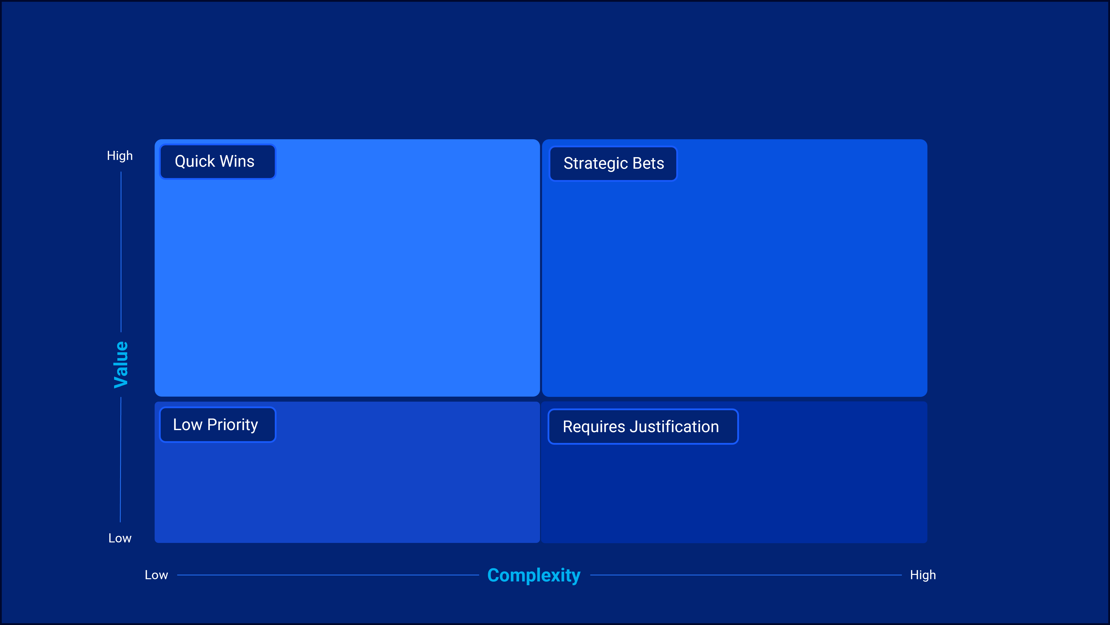
Where do we start in revenue cycle?
Denials Management
Patient Access / Registration
Insurance Follow-up
Utilization Review / Case Management
Claims Submission
Coding
Pre-Registration
Patient Payment Estimation

Slide 4





The Growing Challenges of Healthcare Denials​
How claim denials impact finances, operations, and patient care​
Managing denials is a time-consuming, expensive process that puts financial and operational strain on healthcare providers. This process is highly manual, leading to delays and revenue loss.​
1. Denial Rates Are Rising
2. Operational Burden
51% increase in inpatient denial rates since 2021
4.3% of inpatient and 2.9% of outpatient claims were denied in 2023
16.7% higher Medicaid and Medicare Advantage denial rates
50% of denials are reviewed manually​
54.3% of denied claims are eventually overturned, but through costly appeals
3. Financial Consequences
4. Administrative Costs Are High
$5 million lost annually per hospital due to denied claims.​$262 billion in claims were denied, with $8.6 billion spent on appeals in 2023
$19.7 billion spent annually by healthcare systems reworking denied claims
5. Impact on Patient Care
What if you could reduce denials and improve cash flow with AI-driven automation? Our Agentic AI-powered RPA solutions simplify denial management, improve accuracy, and maximize reimbursement.
56% increase in Medicare Advantage denials from 2022-2023, leading to care delays

Slide 5

Fast-track Denials Management with Accelirate's AI-Powered RPA Solutions ​
By combining the cognitive intelligence of Agentic AI with the efficiency of RPA, your organization can experience:​
Reduction in Denial Rates​
Accelerated Denial Resolution​
Higher First-Pass Approval Rates​
Lower Costs for Denials Rework​
Actionable Insights for Continuous Improvement​
Agentic AI analyzes historical data to identify root causes of denials.​
RPA automates claim submissions with precise data validation, minimizing errors.​
Agentic AI prioritizes denials based on complexity and likelihood of successful appeals.​
RPA automates correction and resubmission processes.​
AI-driven data insights improve claim accuracy before submission.​
RPA ensures consistency in claim submission workflows.​
Automation reduces manual processing efforts and saves time.
AI-driven analytics prevent recurring denial patterns.​
Agentic AI identifies trends and provides recommendations to improve processes.​
RPA ensures consistent implementation of these improvements.​
Outcome
Outcome
Outcome
Outcome
Outcome
Fewer denials due to administrative errors or documentation issues.​
Faster turnaround times, improved cash flow, and reduced aging claims.​
More claims approved on the first attempt, cutting down on rework.​
Lower operational costs with overall higher ROI and better resource allocation.
Continuous reduction in denials and a more efficient revenue cycle

Slide 6



Evolution of Denied Claims with Automation & AI
Only a full platform provides holistic value
Incremental Platform Capabilities
Evolution of Automation
All Manual Work
Denial Identification
Denials Analysis
Denial Documentation
Appeal Process Decision
Appeal Preparation
Denial Appeal Submission
Follow-Up
Appeal Decision Review
Final Resolution
Root Cause Analysis
Reporting & Continuous Improvement
Utilizing RPA
Denial Identification
Denials Analysis
Denial Documentation
Appeal Process Decision
Appeal Preparation
Denial Appeal Submission
Follow-Up
Appeal Decision Review
Final Resolution
Root Cause Analysis
Reporting & Continuous Improvement
Utilizing Agentic Automation
Denial Identification
Denials Analysis
Denial Documentation
Appeal Process Decision
Appeal Preparation
Denial Appeal Submission
Follow-Up
Appeal Decision Review
Final Resolution
Root Cause Analysis
Reporting & Continuous Improvement
Employee Work
Partial Automation
Automation
Human in the loop for input and validation
RPA for repetitive, rule-based decisions
Agent for non-deterministic intelligent automation
Notes:
Utilizeing RPA
RPA - System of Record Integration (UI or API)
RPA - Rules Based Validation
RPA - Third Party Interfaces
IDP - Document Understanding to Extract DenialCodes and Patient Information
Human In The Loop - Aggregated Review via ActionCenter/Apps
Utilizing Agentic Automation
Agent – Intelligent Denial Summarization &Recommended Remediation
Agent – Clinical Evidence Retriever
Agent – Appeal Correspondence Generation

Slide 7


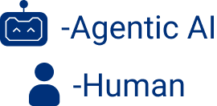

How AI-Powered Assistance Supports Your Healthcare Teams in Managing Denials
01
Denial Capture & Documentation
02
Advanced AI & RPA Solutions
03
​Tailored Implementation
Appeal Decision & Preparation
Resolution and Improvement
Appeal Submission & Follow-Up
What tasks in your revenue cycle could benefit from automation?
Let's discuss!

Slide 8
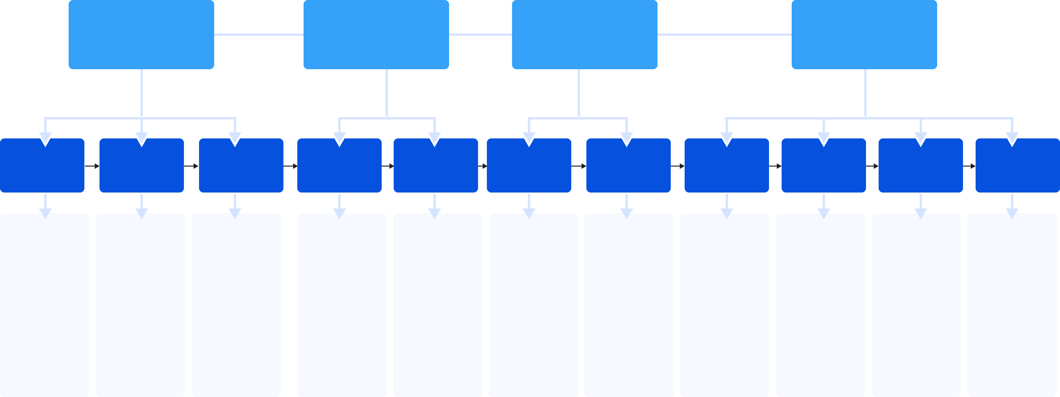



Health Care Employee and AI Assistant Relationship
Denial Capture and Documentation
Appeal Decision and Preparation
Appeal Submission and Follow-Up
Resolution and Improvement
Denial Identification
Denial Analysis
Denial Documentation
Appeal Process Decision
Appeal Preparation
Denial Appeal Submission
Follow-Up
Appeal Decision Review
Final Resolution
Root Cause Analysis
Reporting & Continuous Improvement
Extract denial claim notifications from payor portals, emails, or EDI files.
Identify and categorize denials based on payer codes & messages.
Highlight high-priority denials.
Use historical data and payer-specific rules to analyze denial reasons.
Cross-check denial reasons against payer contracts and claim documentation.
Recommend root causes for denials.
Populate claims management system with denial details.
Link denial information to associated claims for follow-up.
Provide audit trails by storing denial notifications and supporting documents in a centralized repository.
Evaluate denial reason to determine appeal eligibility.
Flag denials that require further review.
Provide a confidence score or recommendation for appeal based on historical data.
Draft appeal letter tailored to payer-specific requirements.
Collect supporting documentation.
Organize documents into the required format for appeal submission.
Recommend additional material needed per denial category.
Submission of appeal via payer portal, emails, or other means.
Validate submission completeness.
Tral appeal submission deadlines and escalate urgent cases nearing deadlines.
Monitor appeal statuses via payer portals, emails, or APIs.
Send follow-up reminders to payers for delayed responses.
Escalate cases flagged as unresolved or requiring further documentation.
Analyze payer responses to appeals and determine next steps.
Recommend secondary actions for denied appeals.
Update claim status in the system based on payer decision.
Close resolved cases in the system, marking them as approved, denied, written-off, etc
payment reconciliation for approved appeals.
Route unresolved claims for further actions.
Analyze trends in denial reasons to identify recurring issues.
Highlight areas for operational improvement.
Provide predictive insights based on historical data.
Detailed reports on denial rates, appeal outcomes, and payer performance.
Recommendations for process changes to reduce denial rates.
Create dashboards for real-time monitoring.
Let's discuss!

Slide 9
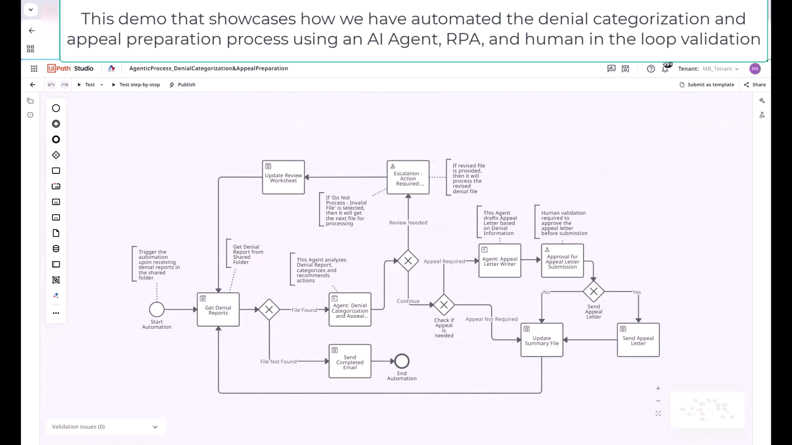
Demonstration of Denials Categorization and Appeal Prep
Notes:
Introduction to Agentic Automation: The process of using agentic automation to help the revenue cycle team interpret complex payer responses, identify denial types, and decide on the next steps while adhering to payer-imposed deadlines. 0:00
Denial Management Challenges: Speaker highlighted that denial management in healthcare is typically a costly, fragmented, and manual process. 0:18
Agentic Solution Benefits: Speaker explained that the agentic solution aims to accelerate revenue recovery, reduce manual workflow, and enable smarter decision-making. 0:22
Process Overview: Speaker described the process, mentioning the creation of two agents for denial categorization and drafting appeals, and the use of RPS processes for supporting the agents. 0:29
Bot Functionality: Speaker demonstrated the bot's functionality, including uploading denial files to a storage bucket, creating output summary files in OneDrive, and processing transactions one by one. 1:36
Denial Report Example: Speaker provided an example of a denial report file and explained how the bot extracts information in a user-friendly manner. 2:35
Appeal Drafting and Human Approval: Speaker detailed the process of the bot drafting appeal letters, sending them for human approval, and updating the EMR applications based on the approval status. 4:11
Final Steps and Email Notification: Speaker concluded by explaining that the bot processes all transactions, updates the summary file, and sends a completed email with the summary file link. 7:44

Slide 10
The Denials Management Journey
Stage 1
Stage 2
Stage 3
Stage 4
Denial Capture & Documentation
Appeal Decision & Preparation
Appeal Submission & Follow-Up
Resolution & Improvement
6-8 Months / 35% of Opportunity
8-10 Months / 30% of Opportunity
6-8 Months / 20% of Opportunity
6 Months / 15% of Opportunity
Goals
Establish centralized intake of all denials across 835s, EOBs, and payer portals
Eliminate manual logging and improve categorization accuracy
Provide real-time denial visibility to prioritize high-value claims
Accelerate decision-making on which denials to appeal
Improve compliance and payer-specific alignment in appeal letters
Standardize supporting documentation collection
Ensure timely, error-free submission of all appeals
Eliminate missed deadlines and manual portal checks
Provide real-time payer response tracking
Deliver continuous insights to reduce systemic denial causes
Enable proactive prevention of high-risk denials
Provide leadership dashboards for denial trends and payer behaviors
Use Cases
Automated denial code extraction
Denial classification by payer/type
Trend monitoring & alerts
Centralized denial repository
AI-driven appeal prediction (probability scoring)Automated appeal letter generation
Document retrieval from EHR/coding systems
Clinician e-signature workflow
Automated appeal submission (portals, EDI, clearinghouses)Receipt confirmation logging
Payer portal monitoring
Exception-based alerts to staff
Appeal outcome tracking and analytics
Root cause analysis (eligibility, coding, prior auth)Continuous improvement feedback to upstream workflows
Predictive denial prevention (flagging claims pre-submission)
Notes:
Where to start, why it matters.

Slide 11



Denial Capture & Documentation Agent
Business Challenges
90%
Reduction in denial backlog
Financial Impact
$262B lost annually due to denied claims; ~65% of denials never resubmitted
Manual denial tracking is time-consuming and prone to errors
Lack of real-time visibility into root causes leads to recurring denials
Reduces labor costs tied to manual intake and increases recoveries from high-value denials that would otherwise be overlooked.
Process Workflow
Unattended Automation
Quick Wins
Capture Denial
Extract Codes & Reasons
Classify by Payer/Type
Validate Against Claim
Store in Central Repository
Real-Time Denial categorization
Downstream Impact
Feeds accurate, structured denial data into appeals and resolution workflows, improving downstream decision-making.
Technology Platforms: Any EHR Platform
Robotic Process Automation
Employee Supervision
Agent
Candidate
Key Automation Opportunities
Automated Denial Intake & Classification
Smart Documentation & Validation
Analytics-Driven Prioritization
Automated Trend Alerts
Millions
Recovered from unworked denials
Efficiency Gain
Captures denial reason codes directly from 835s, EOBs, and payer portals.
Automatically maps codes to standardized categories (CO, PR, OA, etc.) for consistent reporting.
Creates standardized denial records inside RCM/EHR systems, eliminating manual entry.
Detects missing claim details or inconsistent data (e.g., patient ID mismatch, coding gaps) and flags for review.
Ranks denials based on financial impact, payer type, and likelihood of recovery.
Routes high-priority claims to work queues automatically.
Provides real-time dashboards highlighting spikes in denial types (e.g., eligibility errors).
Notifies staff of potential systemic issues before they escalate.
Cuts intake and classification from hours to minutes, enabling faster intervention.
Notes:
Need 1 slide per agent.

Slide 12
Appeal Decision & Preparation Agent
Business Challenges
< 5 min
To draft an appeal
Financial Impact
Appeal decisions often exceed payer deadlines
Staff spend hours drafting inconsistent appeals
No visibility into success likelihood wastes effort
Increases revenue recovery from overturned denials while lowering costs from unnecessary appeals.
Process Workflow
Unattended Automation
Quick Wins
Identify Eligible Appeals
Gather Documentation
Generate Draft Appeal
Clinician Review/ Approval
30%
Increase in overturn success rate
Downstream Impact
Delivers consistency and compliance in appeal quality, reducing audit risk and strengthening payer relationships.
Technology Platforms: Any EHR Platform
Robotic Process Automation
Employee Supervision
Agent
Candidate
Key Automation Opportunities
AI-Driven Appeal Prediction
Automated Appeal Drafting
Streamlined Review & Compliance
Dynamic Knowledge Base
Reduced
Wasted effort on low-probability cases
Efficiency Gain
Evaluates payer history and denial type to determine probability of success.
Filters out denials unlikely to overturn, saving resources.
Generates payer-specific appeal letters in <5 minutes.
Pulls relevant EHR notes, coding data, and medical necessity documentation into templates.
Routes draft appeals to clinicians for e-signature with audit trails.
Ensures all submissions meet payer-specific compliance requirements.
Learns from historical appeal outcomes to refine future drafting.
Provides staff with recommendations on which arguments work best by payer.
Reduces preparation from hours to minutes, empowering small teams to manage larger appeal volumes.
Notes:
Need 1 slide per agent.

Slide 13
Appeal Submission & Follow-Up Agent
Business Challenges
Instant
Payer submissions
Financial Impact
Missed deadlines due to payer-specific submission rules
Manual follow-ups waste staff time and cause lost appeals
Poor visibility into payer response timelines
Accelerates reimbursement and prevents lost revenue from missed filing deadlines.
Process Workflow
Unattended Automation
Quick Wins
Submit Appeals
Confirm Receipt
Monitor Payer Portal
Update Status
Alert Staff if Action Needed
Zero
Missed deadlines
Downstream Impact
Improves payer transparency and cash flow predictability with real-time monitoring.
Technology Platforms: Any EHR Platform
Robotic Process Automation
Employee Supervision
Agent
Candidate
Key Automation Opportunities
Automated Submission Across Payers
Proactive Status Monitoring
Closed-Loop Updates
Exception-Based Alerting
Shorter
A/R cycle
Efficiency Gain
Submits appeals directly through portals, clearinghouses, or EDI connections.
Confirms receipt instantly, capturing reference IDs.
Continuously monitors payer systems for status changes.
Escalates exceptions like missing documentation or delayed responses.
Feeds payer status updates back into RCM/EHR work queues automatically.
Keeps all case notes current without staff intervention.
Sends proactive alerts only when manual action is needed (e.g., medical review required).
Prevents staff from wasting time on routine follow-up.
Eliminates manual portal checks and calls, letting staff focus on exceptions.
Notes:
Need 1 slide per agent.

Slide 14
Resolution & Improvement Agent
Business Challenges
Up to 30%
Reduction in denial rates
Financial Impact
Lack of feedback loops leads to recurring denials
Under-analysis of trends prevents systemic fixes
Leadership lacks real-time insights for payer strategy
Reduces repeat denials and long-term revenue leakage by preventing systemic issues.
Process Workflow
Unattended Automation
Quick Wins
Collect Outcomes
Analyze Trends
Identify Root Causes
Recommend Fixes
Implement Updates
Real-time
Denial trend dashboards
Downstream Impact
Feeds insights to coding, registration, and prior auth processes, improving overall claim quality.
Technology Platforms: Any EHR Platform
Robotic Process Automation
Employee Supervision
Agent
Candidate
Key Automation Opportunities
Outcome Tracking & Analytics
Root Cause Identification
Continuous Improvement Feedback Loop
Predictive Prevention
Continuous
Feedback to upstream teams
Efficiency Gain
Captures outcomes of appeals in real-time (approved, partially paid, denied again).
Provides reporting by payer, denial type, and service line.
Identifies recurring issues in eligibility, coding, prior auth, or clinical documentation.
Links denial reasons back to specific workflows upstream.
Automates delivery of insights to coding, registration, and care teams.Suggests specific corrective actions based on trends.
Uses historical data to flag claims likely to be denied before submission.
Enables proactive corrections (e.g., coding fix, missing prior auth) to prevent denials altogether.
Delivers instant dashboards and recommendations, replacing weeks of manual analysis.
Notes:
Need 1 slide per agent.

Slide 15


Proven Results with AI-Powered Solutions
Client Success Stories
Hospital (500 beds)
What Our Clients Say
Reduced denial rates by 22% in six months, recovering $2.5M in lost revenue.
Our denial rates dropped significantly, and our team finally has more time to focus on complex cases. Accelirate’s AI agents transformed our workflows and boosted our revenue recovery!
Healthcare System
Cut claims resolution time by 37%, significantly improving cash flow and reducing accounts receivable backlogs.​
Multi-Specialty Clinic
​Ready to achieve results like these?
Used AI-driven alerts to improve collaboration between billing and clinical teams, reducing errors and increasing efficiency.
Let’s talk!

